Slide 1
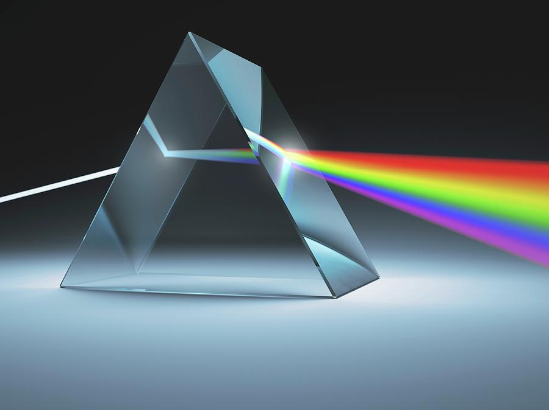

Image formation
Yoni Chechik
www.AIisMath.com

Slide 2
References
http://szeliski.org/Book/
http://www.cs.cornell.edu/courses/cs5670/2019sp/lectures/lectures.html
http://www.cs.cmu.edu/~16385/

Slide 3
Contents
BRDF
Pinhole camera
Digital camera
The human eye

Slide 4
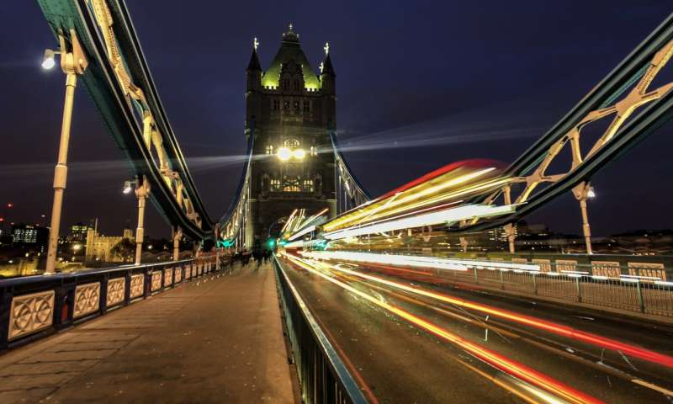
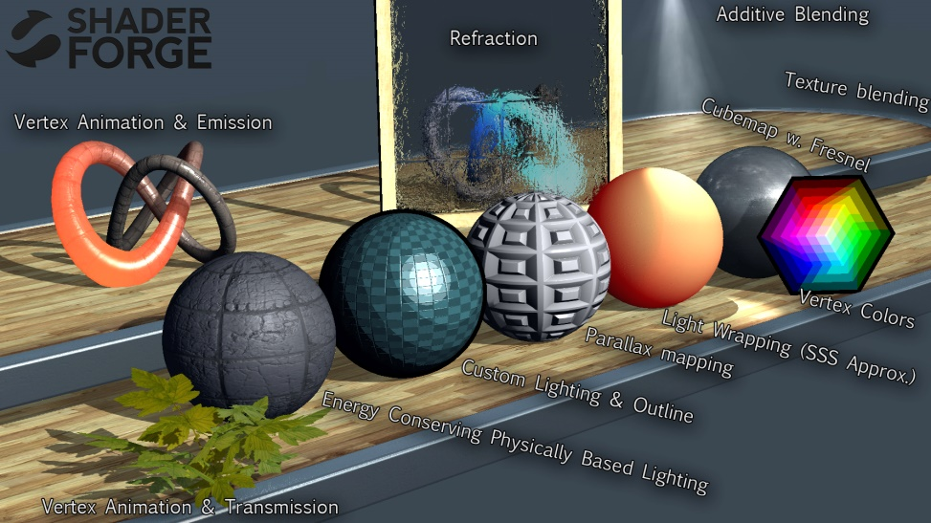
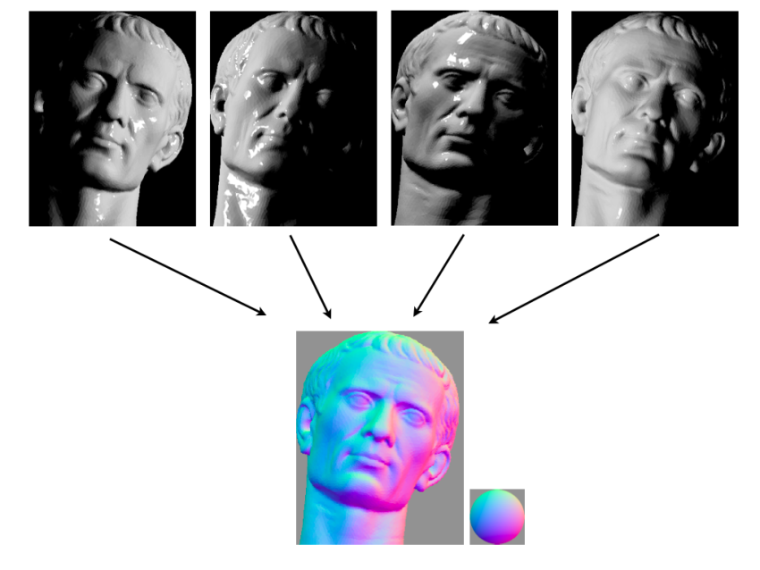

Some motivation
Art
(Exposure time)
3D game rendering
(ray tracing)
Computational photography
(shape from shading- 3D reconstruction)
Computational photography
(aperture blur shape)

Slide 5
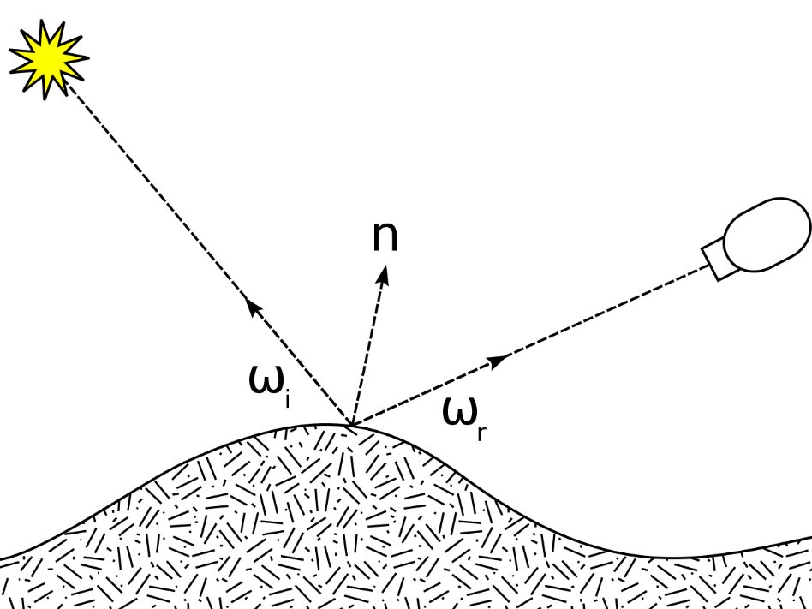
Image formation
Image formation: what happens before the image is captured- how is it captured and why do we see it the way the we see it.

Slide 6
Contents
BRDF
Pinhole camera
Digital camera
The human eye

Slide 7
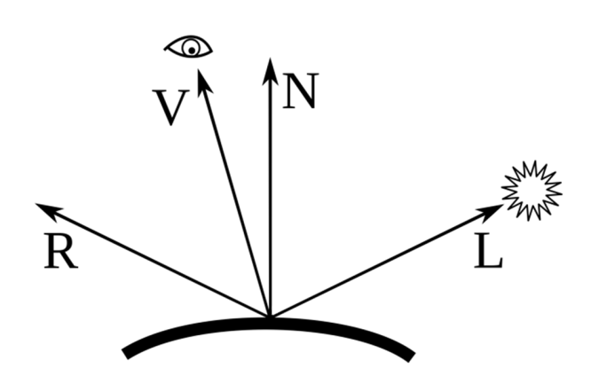
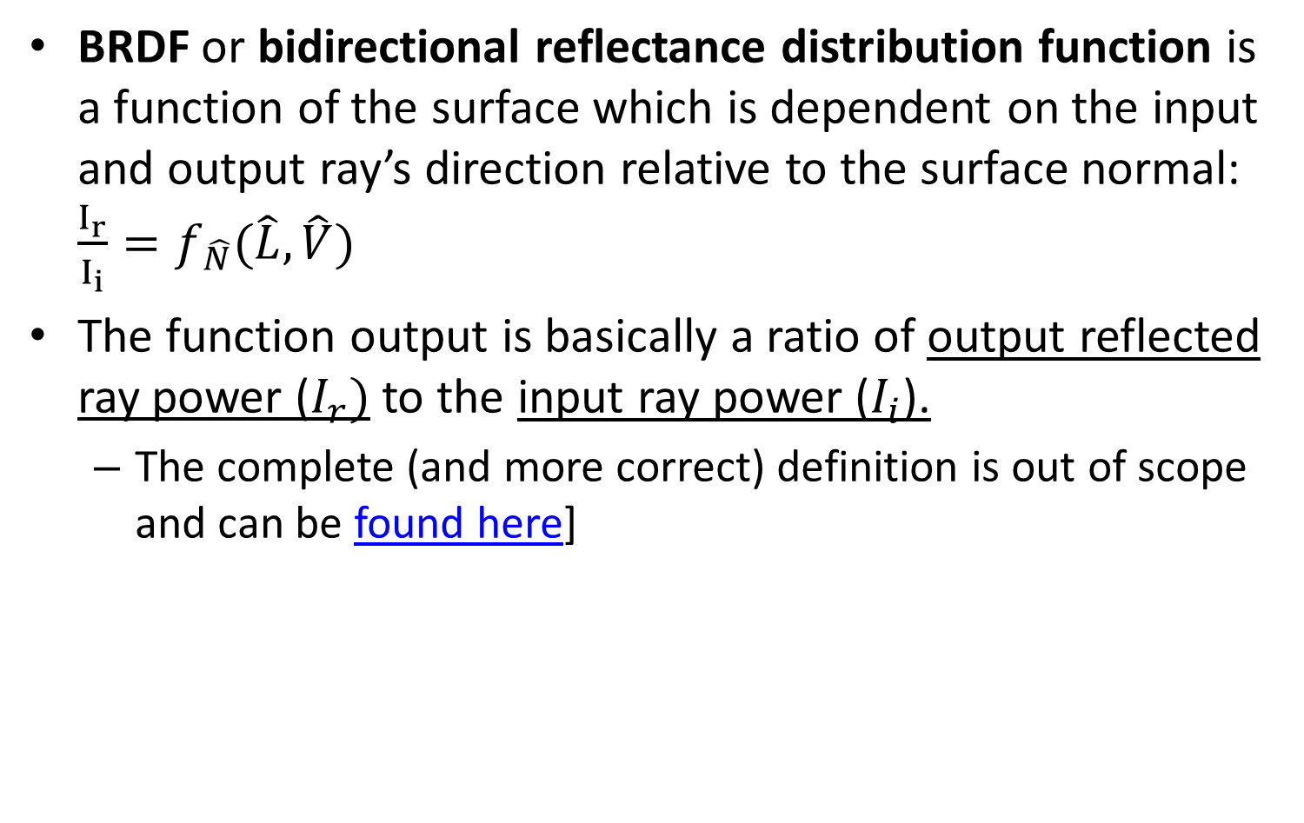
BRDF
BRDF or bidirectional reflectance distribution function is a function of the surface which is dependent on the input and output ray’s direction relative to the surface normal: $\frac{I_{r}}{I_{i}}=f_{\hat{N}}(\hat{L},\hat{V})$
The function output is basically a ratio of output reflected ray power ($I_{r})$ to the input ray power ($I_{i}$).
The complete (and more correct) definition is out of scope and can be found here]

Slide 8

BRDF
BRDF is used extensively in photorealistic rendering, and also in 3D reconstruction and image deblurring.
When rendering 3D images with ray tracing, actual rays are generated and propagate through the scene using the BRDF of each material.

Slide 9
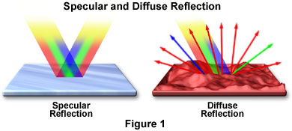
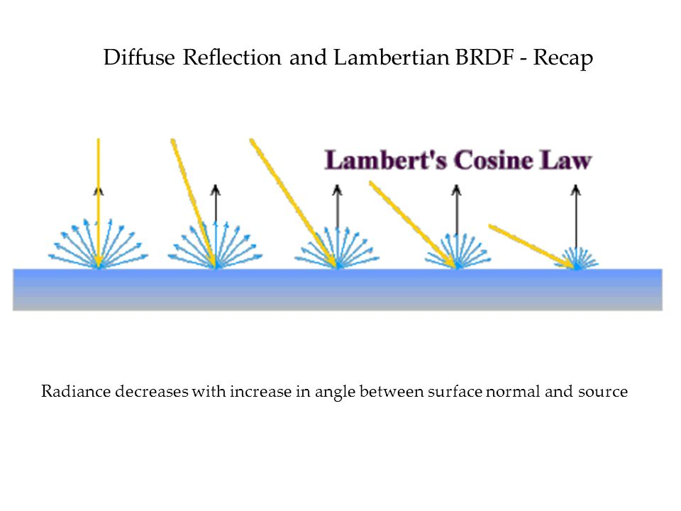
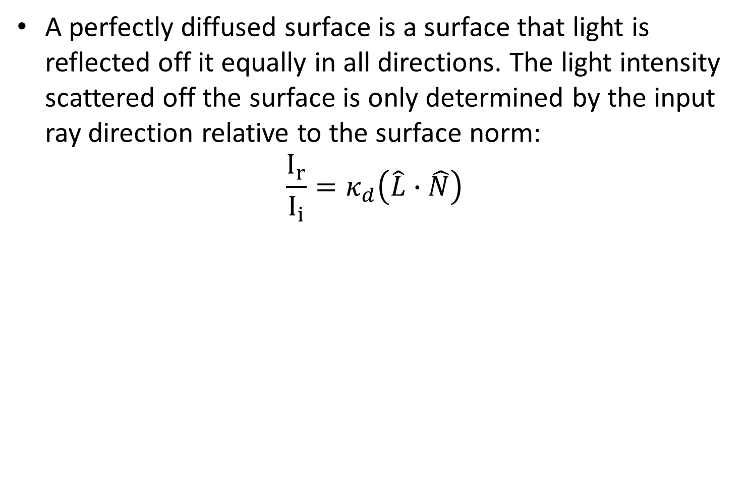
BRDF of a diffused surface
A perfectly diffused surface is a surface that light is reflected off it equally in all directions. The light intensity scattered off the surface is only determined by the input ray direction relative to the surface norm:
$$\frac{I_{r}}{I_{i}}=κ_{d}\left(\hat{L}∙\hat{N}\right)$$
Notes:
The returned angle doesn’t matter:
Eye(x,0,5)- change x
Center(0,0,0)
Light(-5,0,5)
The light on Z surface isn’t changing when changing angle of view.
Now change the lights’ x place and rerun the experiment.

Slide 10
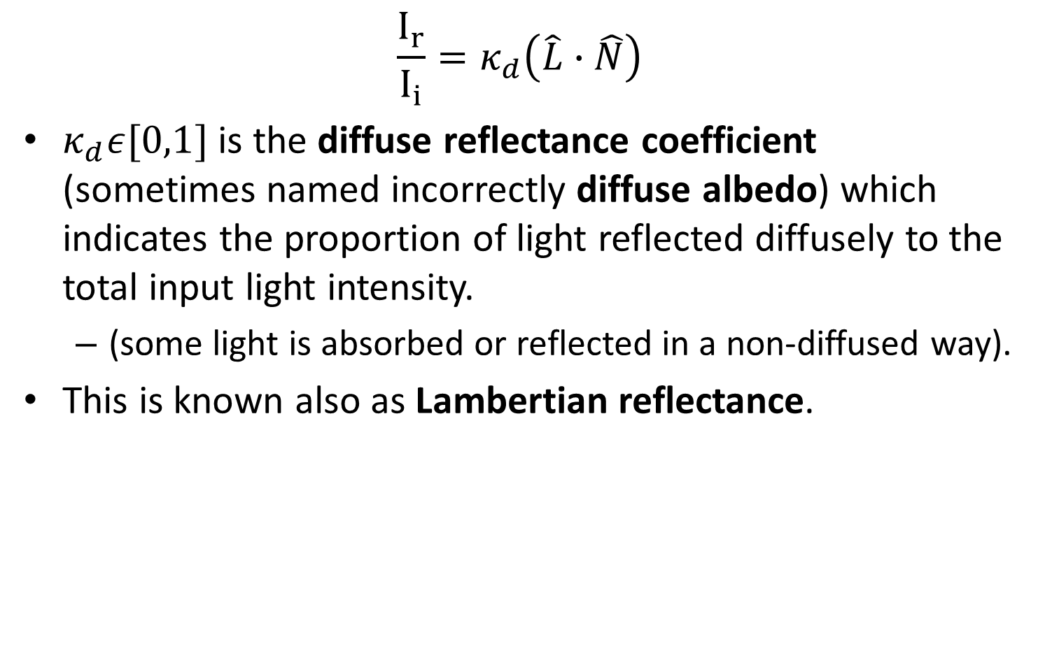
BRDF of a diffused surface
$$\frac{I_{r}}{I_{i}}=κ_{d}\left(\hat{L}∙\hat{N}\right)$$
$κ_{d}ε[0,1]$ is the diffuse reflectance coefficient (sometimes named incorrectly diffuse albedo) which indicates the proportion of light reflected diffusely to the total input light intensity.
(some light is absorbed or reflected in a non-diffused way).
This is known also as Lambertian reflectance.
Notes:
The returned angle doesn’t matter:
Eye(x,0,5)- change x
Center(0,0,0)
Light(-5,0,5)
The light on Z surface isn’t changing when changing angle of view.
Now change the lights’ x place and rerun the experiment.

Slide 11
BRDF of a diffused surface
Diffused surface demo: http://learnwebgl.brown37.net/09_lights/lights_diffuse.html#a-webgl-demo-program-for-diffuse-lighting

Slide 12
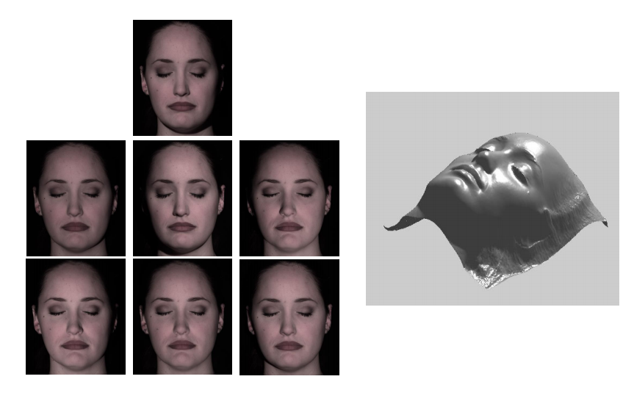

Side note: photometric stereo
Estimating surface normals from 2D images of different lighting conditions.
Assumes Lambertian surface.
Assumes infinite lighting plane (not a light point)- so all distances from the light source are the same intensities…

Slide 13
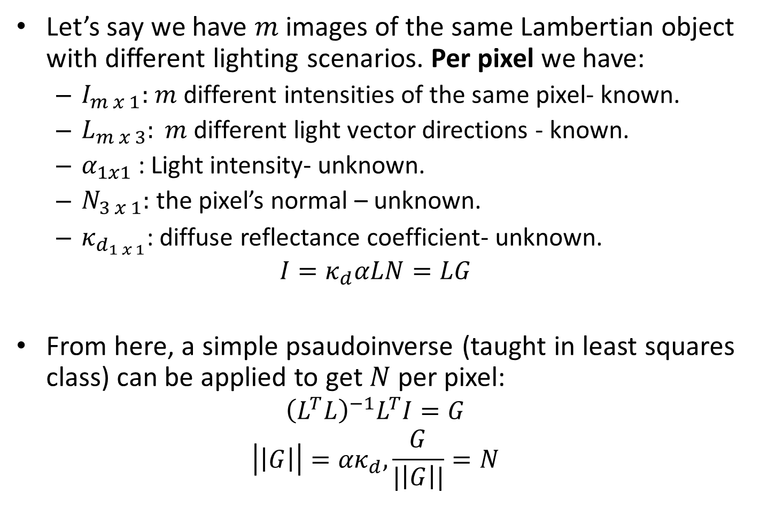
Side note: photometric stereo
Let’s say we have $m$ images of the same Lambertian object with different lighting scenarios. Per pixel we have:
$I_{m x 1}:$ $m$ different intensities of the same pixel- known.
$L_{m x 3}: m$ different light vector directions - known.
$α_{1x1}$: Light intensity- unknown.
$N_{3 x 1}:$ the pixel’s normal – unknown.
$κ_{d_{1 x 1}}$: diffuse reflectance coefficient- unknown.
$$I=κ_{d}αLN=LG$$
From here, a simple psaudoinverse (taught in least squares class) can be applied to get $N$ per pixel:
$${\left(L^{T}L\right)}^{−1}L^{T}I=G$$
$$\left|\left|G\right|\right|={ακ}_{d},\frac{G}{|\left|G\right||}=N$$

Slide 14





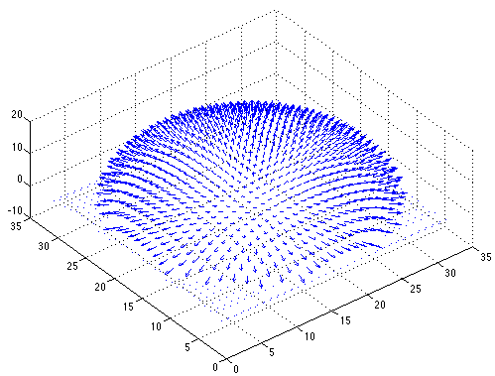

Side note: photometric stereo
Recovered albedo
Recovered normal field
Forsyth & Ponce, Sec. 5.4

Slide 15
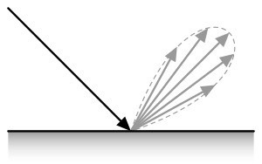
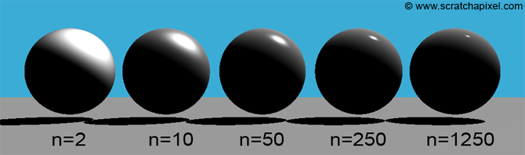
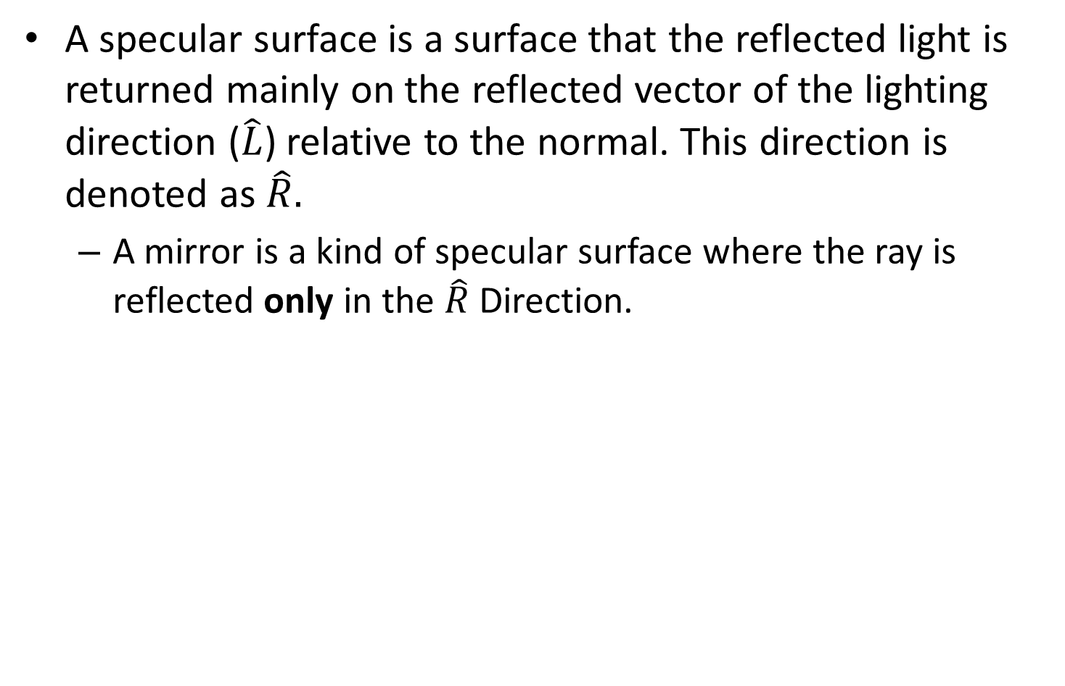
BRDF of a specular surface
A specular surface is a surface that the reflected light is returned mainly on the reflected vector of the lighting direction ($\hat{L}$) relative to the normal. This direction is denoted as $\hat{R}.$
A mirror is a kind of specular surface where the ray is reflected only in the $\hat{R}$ Direction.

Slide 16

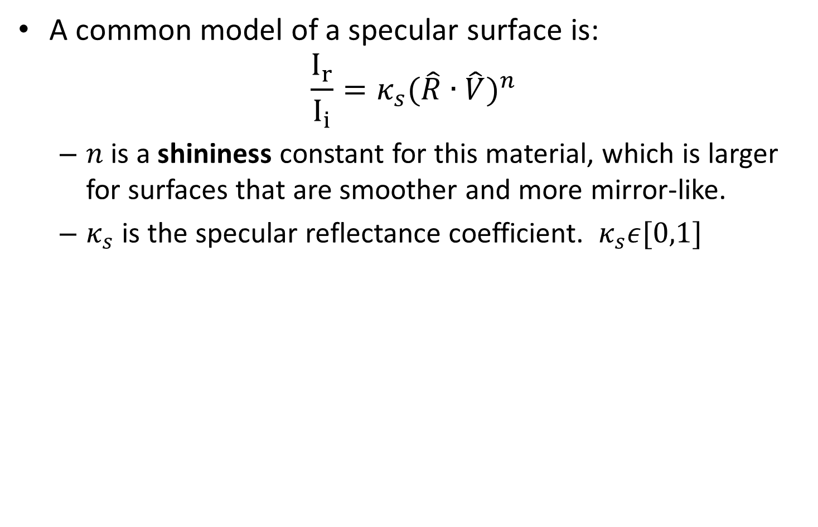
BRDF of a specular surface
A common model of a specular surface is:
$${\frac{I_{r}}{I_{i}}=κ_{s}(\hat{R}∙\hat{V})}^{n}$$
$n$ is a shininess constant for this material, which is larger for surfaces that are smoother and more mirror-like.
$κ_{s}$ is the specular reflectance coefficient. $κ_{s}ε[0,1]$

Slide 17
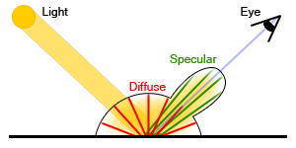
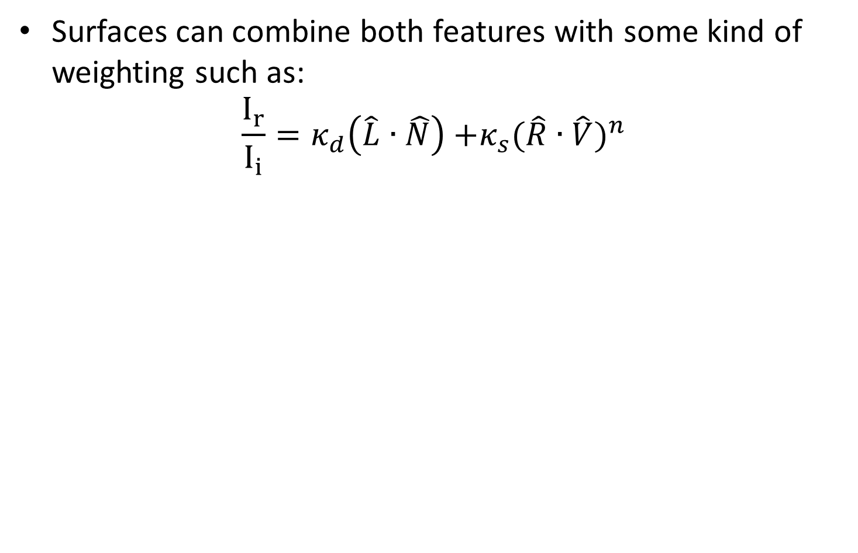
Diffused and specular surface
Surfaces can combine both features with some kind of weighting such as:
$$\frac{I_{r}}{I_{i}}=κ_{d}\left(\hat{L}∙\hat{N}\right){+κ_{s}(\hat{R}∙\hat{V})}^{n}$$

Slide 18
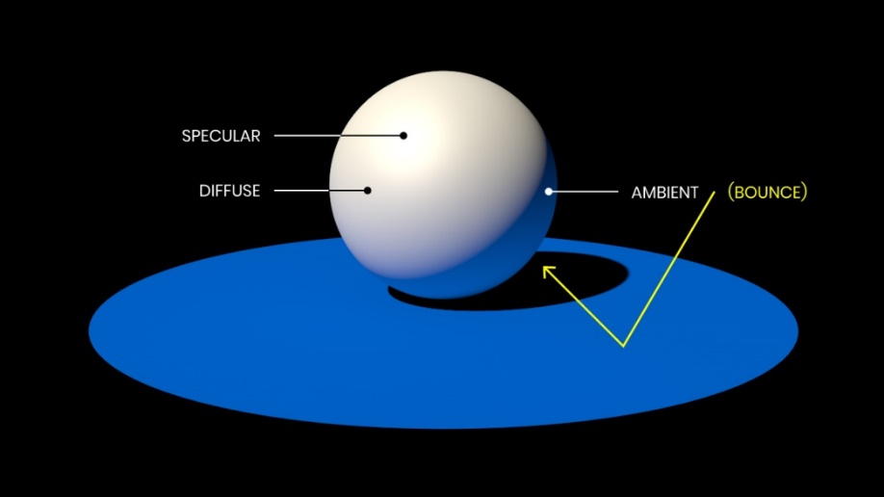
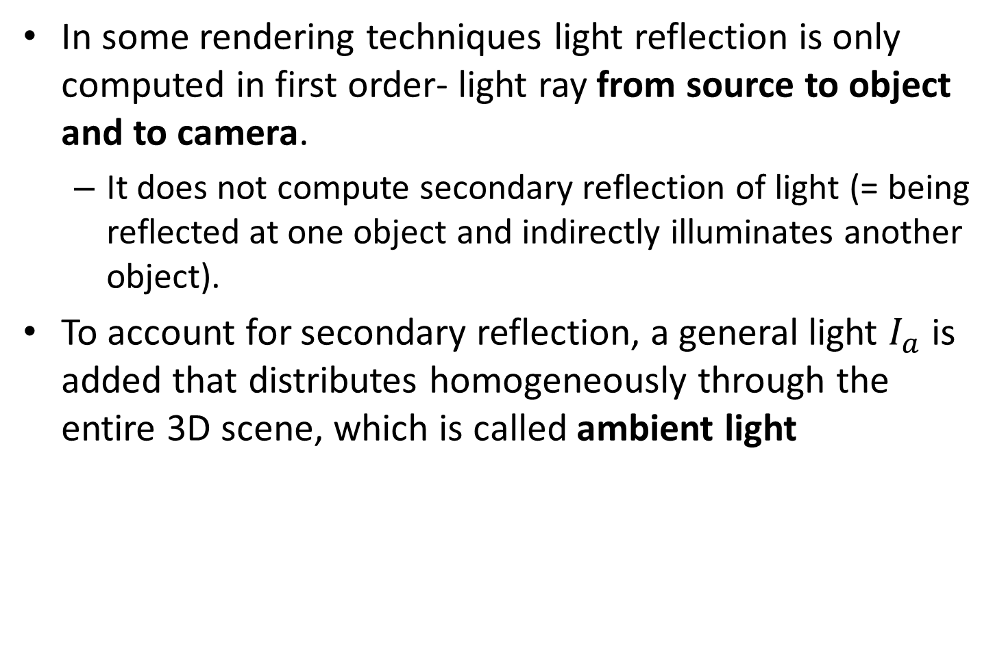
Ambient light
In some rendering techniques light reflection is only computed in first order- light ray from source to object and to camera.
It does not compute secondary reflection of light (= being reflected at one object and indirectly illuminates another object).
To account for secondary reflection, a general light $I_{a}$ is added that distributes homogeneously through the entire 3D scene, which is called ambient light

Slide 19
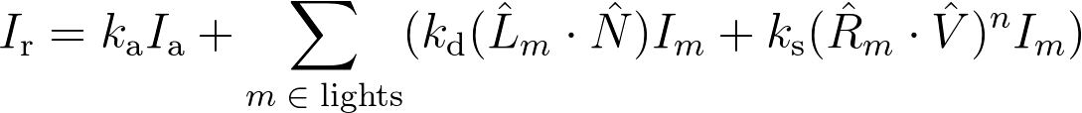
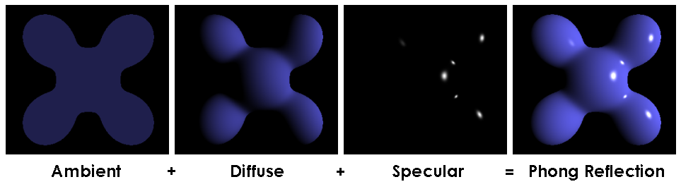
Phong reflection model
Bui Tuong Phong used ambient, diffused and specular reflections in a well known illumination model known as Phong reflection model, based on BRDF:
Demo: http://www.cs.toronto.edu/~jacobson/phong-demo/ (change in dropdown to “Phong shading”…)
Notes:
I_\text{r} = k_\text{a} I_\text{a} + \sum_{m\;\in\;\text{lights}} (k_\text{d} (\hat{L}_m \cdot \hat{N}) I_{m} + k_\text{s} (\hat{R}_m \cdot \hat{V})^{n}I_{m})

Slide 20
Phong model limitations
Phong model doesn’t account for refraction and Interreflections.

Slide 21
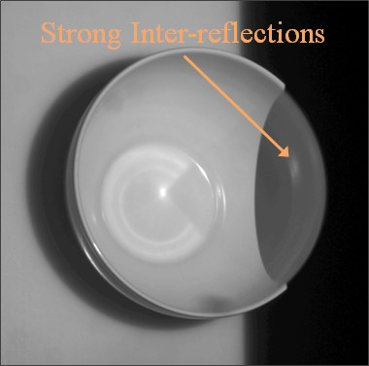
Phong model limitations
interreflection - reciprocal reflection between two reflecting surfaces

Slide 22

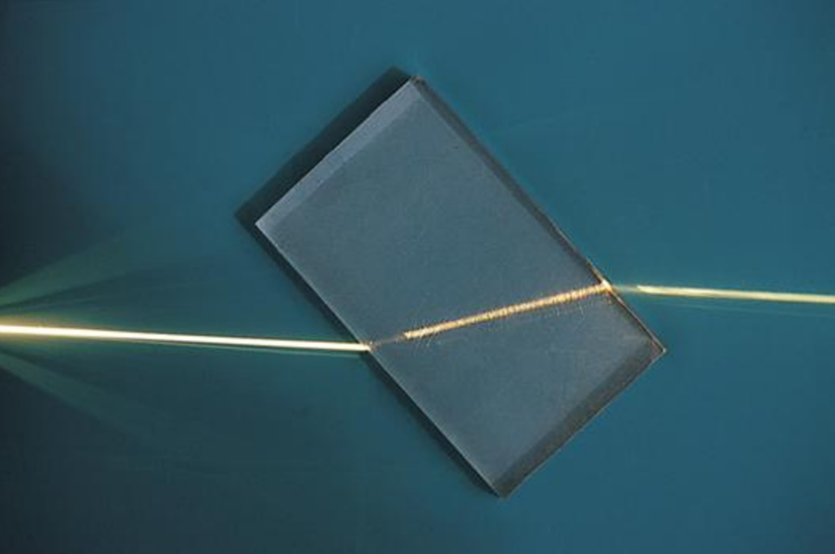
BRDF limitations
BRDF assumes single point of impact. It doesn't account for light rays that refract/scatters through a medium.
Refraction is the change in direction of a wave passing from one medium to another or from a gradual change in the medium.
One point of entry, one (other) point of exit.

Slide 23
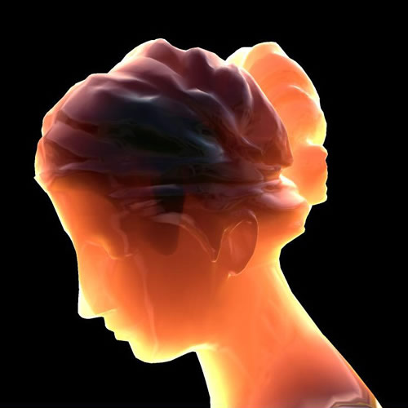
BRDF limitations
Subsurface scattering is a mechanism of light transport in which light that penetrates the surface of a translucent object, is scattered by interacting with the material, and exits the surface at a different point.
One point of entry, multiple exit points.

Slide 24
Wave- particle duality
Wave–particle duality is the concept in quantum mechanics that every particle or quantum entity (such as light) may be described as either a particle or a wave. [Wikipedia]
Refraction is an electromagnetic wave characteristic.
Subsurface scattering is a particle characteristic.

Slide 25
Contents
BRDF
Pinhole camera
Digital camera
The human eye

Slide 26
Pinhole imaging
What would an image taken like this look like?
barrier (diaphragm)
pinhole (aperture)
real-world object
digital sensor

Slide 27
Pinhole imaging
most rays are blocked
real-world object
digital sensor
one makes it through

Slide 28
Pinhole imaging
most rays are blocked
real-world object
digital sensor
one makes it through

Slide 29
Pinhole imaging
Each scene point contributes to only one sensor pixel.
real-world object
digital sensor

Slide 30
Pinhole imaging
Imaged object is inverted.
real-world object

Slide 31
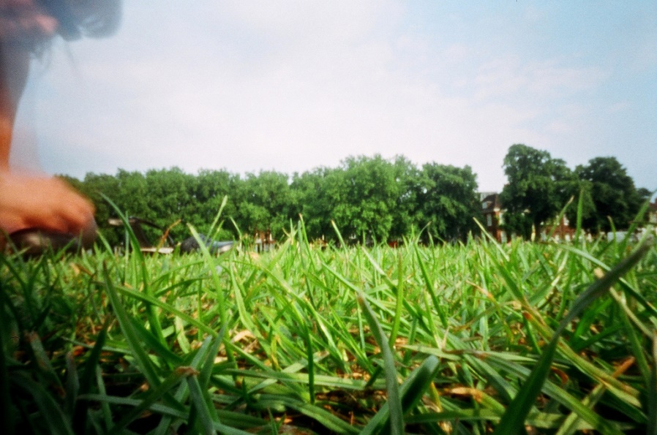
Blur in pinhole cameras
Since only one ray reaches every pixel in the pinhole camera, the image is always in focus.
(blur can come only from movement of camera or objects in time of exposure)

Slide 32

Pinhole camera a.k.a. camera obscura
Camera obscura - from Latin, meaning "dark room“.
First mention …
First camera …
Chinese philosopher Mozi
(470 to 390 BC)
Greek philosopher Aristotle
(384 to 322 BC)

Slide 33
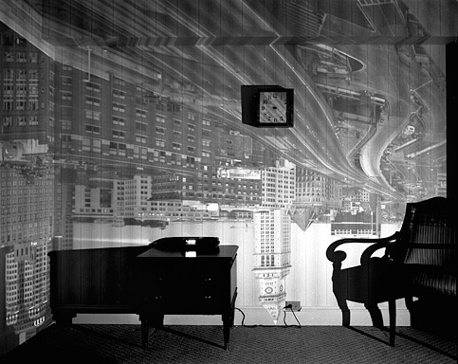
Examples of camera obscura

Slide 34
Examples of camera obscura

Slide 35
Sensor place
What happens as we change the place of the sensor?
real-world object

Slide 36
Sensor place
object projection is half the size.
Changing the sensor plane distance is responsible for zoom in a pinhole camera.
real-world object

Slide 37
Pinhole size
What happens as we change the pinhole diameter?
real-world object

Slide 38

Pinhole size
More light from different points of the object are integrated in the same pixel (integration->sum-> blur).
Changing the pinhole size is responsible for focus in a pinhole camera.
real-world object

Slide 39
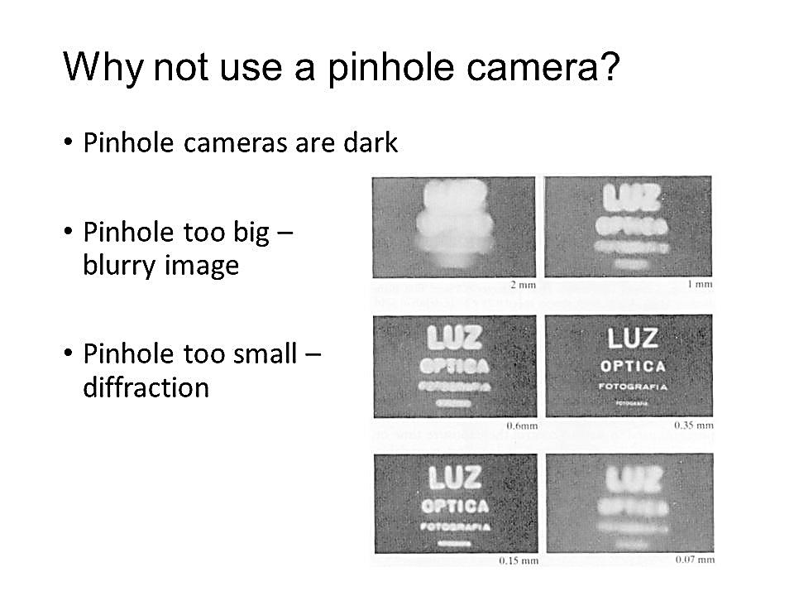
Side note: Pinhole size example
Is smaller pinhole means sharper image?

Slide 40
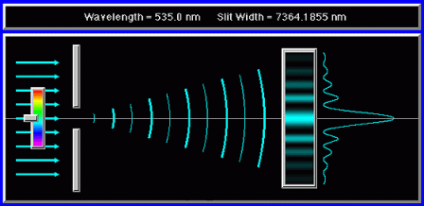
Side note: Pinhole size example
No! due to diffraction (Wave–particle duality of photons).

Slide 41
Contents
BRDF
Pinhole camera
Digital camera
The human eye

Slide 42
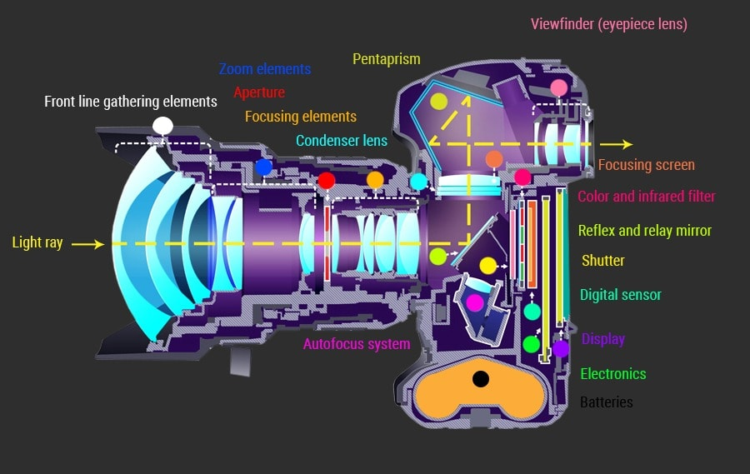
Digital single-lens reflex camera (DSLR)

Slide 43
Digital single-lens reflex camera (DSLR)

Slide 44
Pinhole to lens
All new cameras has lenses in them, what about it?

Slide 45
The lens camera
The lens can replace the pinhole, while giving the advantage of more input light.

Slide 46
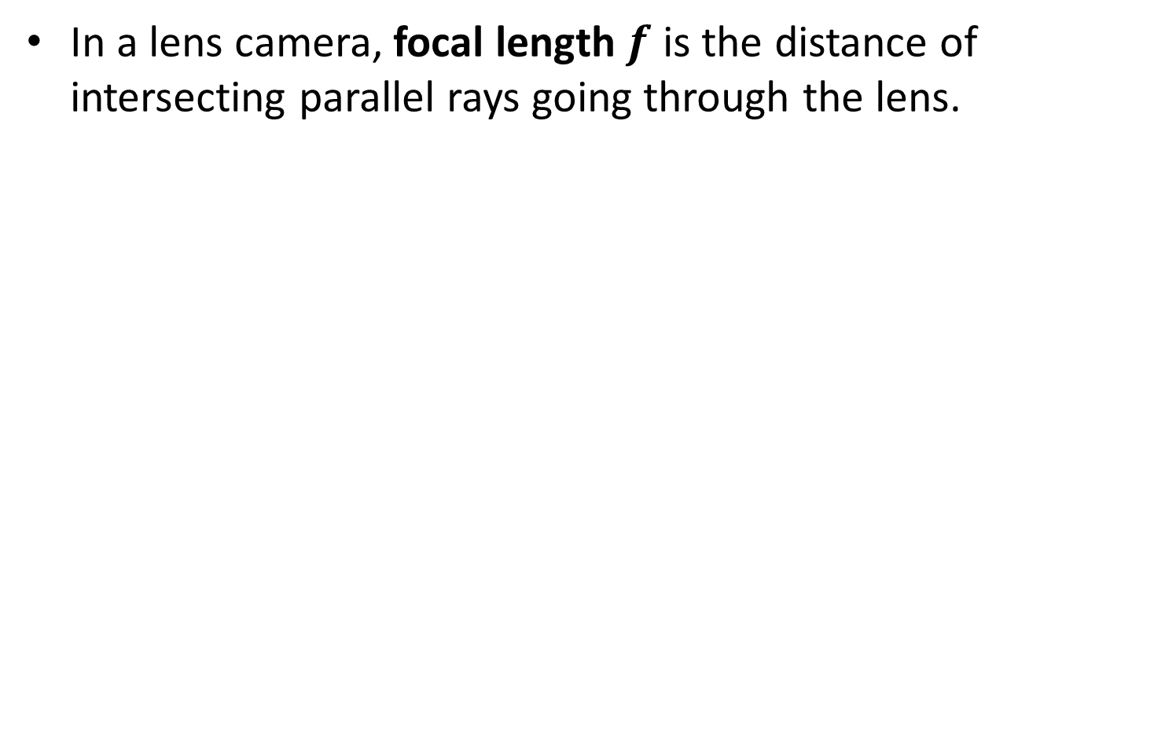
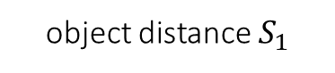
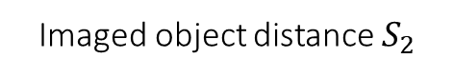

Focal length
In a lens camera, focal length$f$ is the distance of intersecting parallel rays going through the lens.
object distance $S_{1}$
focal length $f$
Imaged object distance $S_{2}$

Slide 47
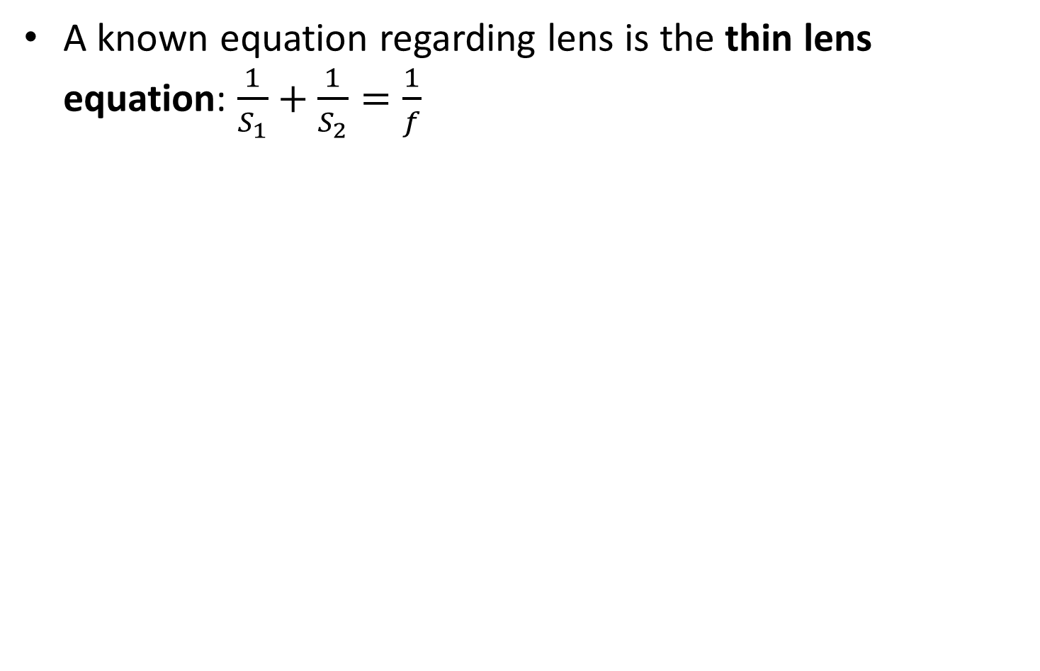
Focal length
A known equation regarding lens is the thin lens equation: $\frac{1}{S_{1}}+\frac{1}{S_{2}}=\frac{1}{f}$
object distance $S_{1}$
focal length $f$
Imaged object distance $S_{2}$

Slide 48
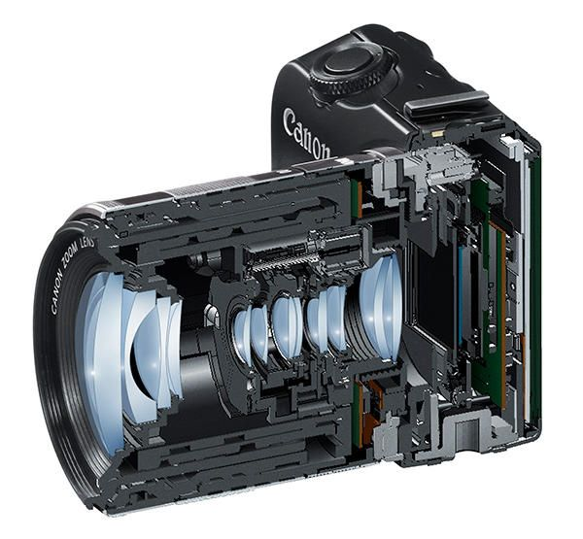
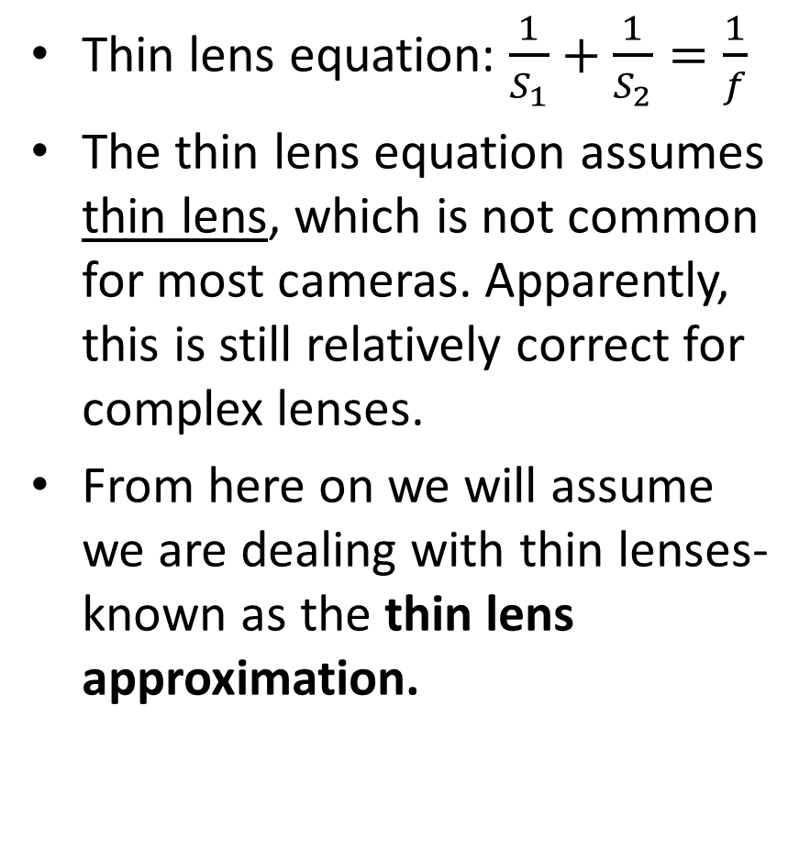
Side note: thin lens approximation
Thin lens equation: $\frac{1}{S_{1}}+\frac{1}{S_{2}}=\frac{1}{f}$
The thin lens equation assumes thin lens, which is not common for most cameras. Apparently, this is still relatively correct for complex lenses.
From here on we will assume we are dealing with thin lenses- known as the thin lens approximation.

Slide 49
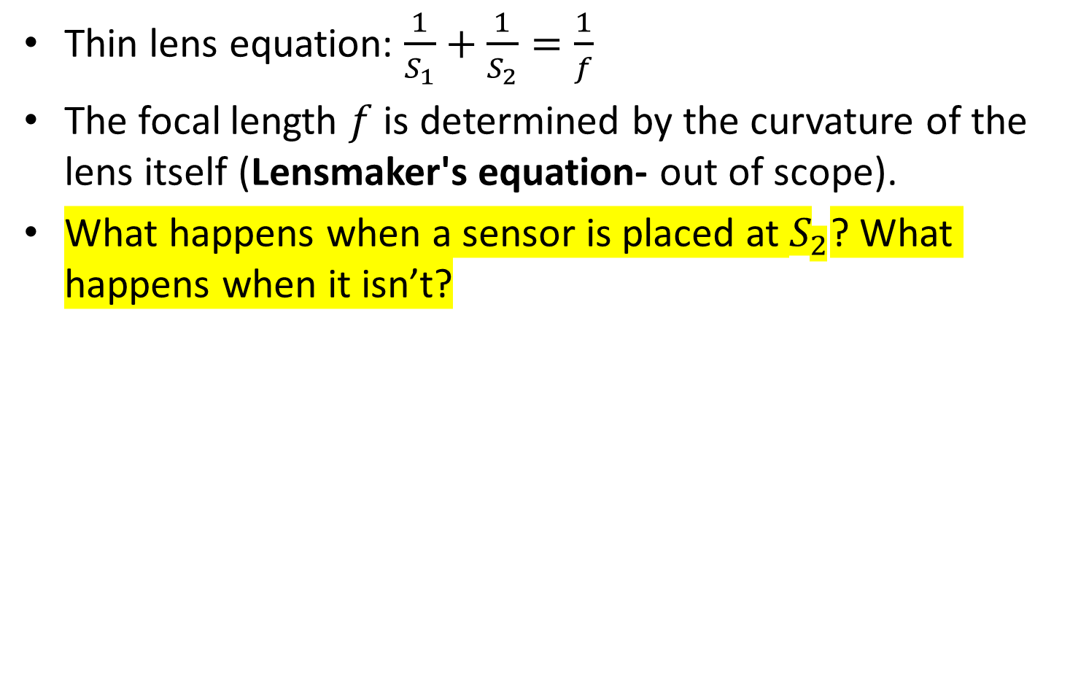
Focal length
Thin lens equation: $\frac{1}{S_{1}}+\frac{1}{S_{2}}=\frac{1}{f}$
The focal length $f$is determined by the curvature of the lens itself (Lensmaker's equation- out of scope).
What happens when a sensor is placed at $S_{2}$? What happens when it isn’t?

Slide 50
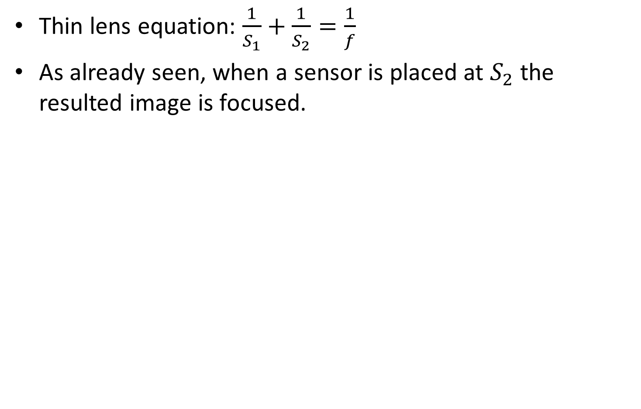



Focal length
Thin lens equation: $\frac{1}{S_{1}}+\frac{1}{S_{2}}=\frac{1}{f}$
As already seen, when a sensor is placed at $S_{2}$ the resulted image is focused.
object distance $S_{1}$
focal length $f$
Focused Imaged object distance $S_{2}$

Slide 51


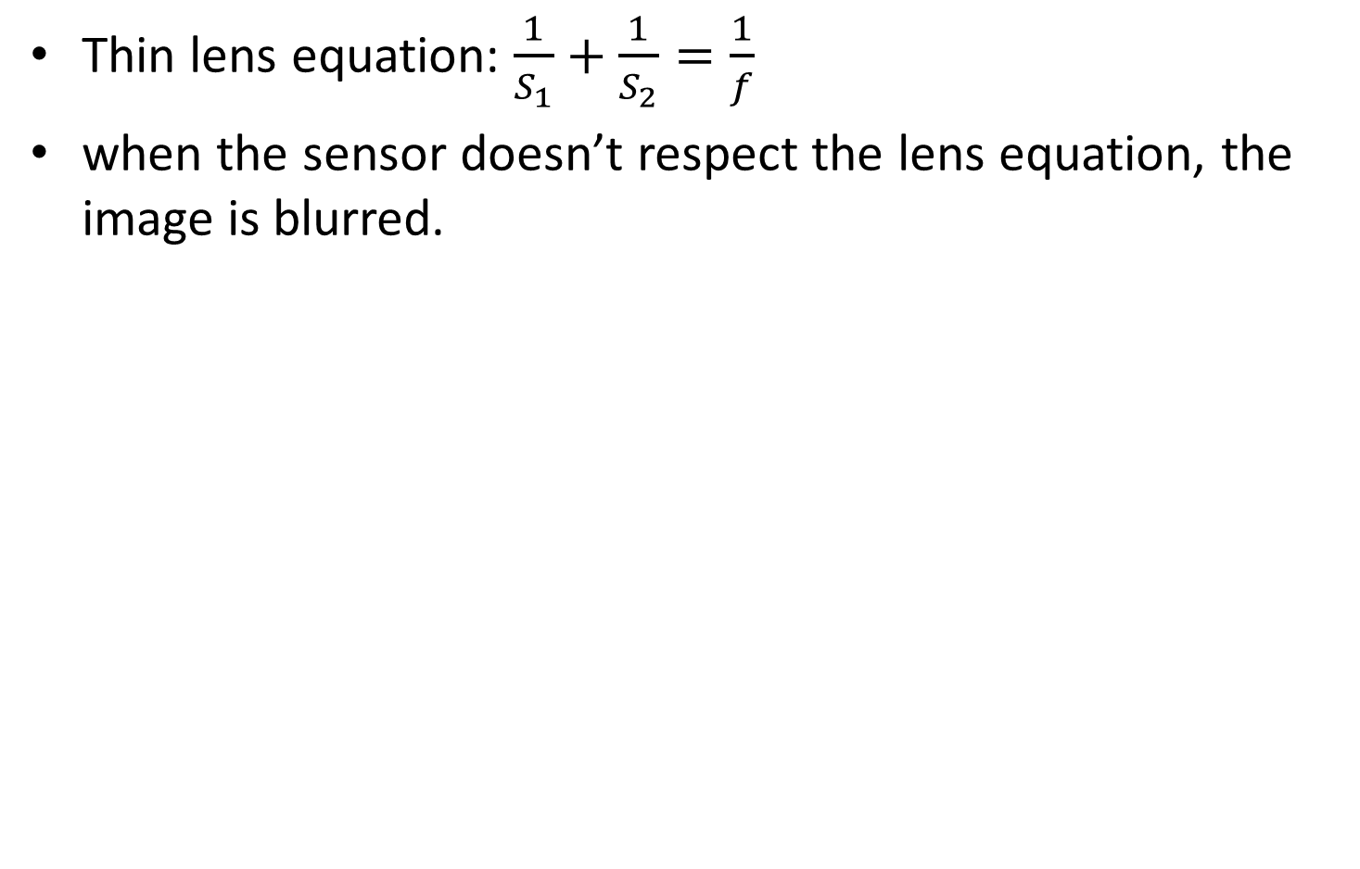


Focal length
Thin lens equation: $\frac{1}{S_{1}}+\frac{1}{S_{2}}=\frac{1}{f}$
when the sensor doesn’t respect the lens equation, the image is blurred.
object distance $S_{1}$
focal length $f$
Unfocused imaged object distance ${S′}_{2}$

Slide 52
Focus
Changing the distance between the sensor and a given lens to make the object sharper.
Changing the focus in a complex lens setup essentially changes the place of the approximated thin lens relative to the sensor.

Slide 53

Zoom
Changing the relation between lenses in complex lens setup effectively changes the focal length of the thin lens approximation and by that changing the size of the perceived object.
focal length $f$

Slide 54
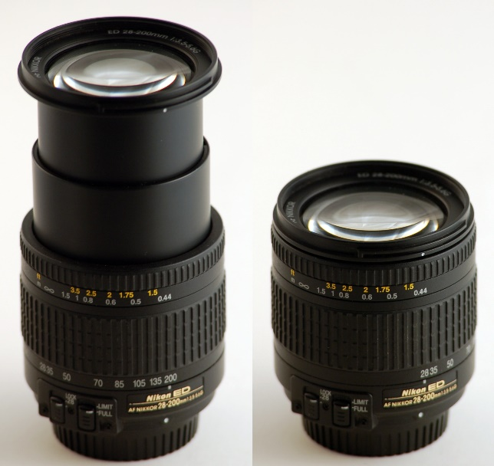
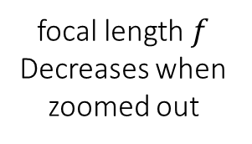
Zoom
Changing the relation between lenses in complex lens setup effectively changes the focal length of the thin lens approximation and by that changing the size of the perceived object.
focal length $f$
Decreases when zoomed out

Slide 55
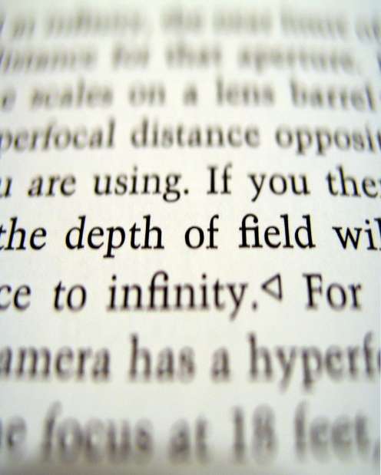
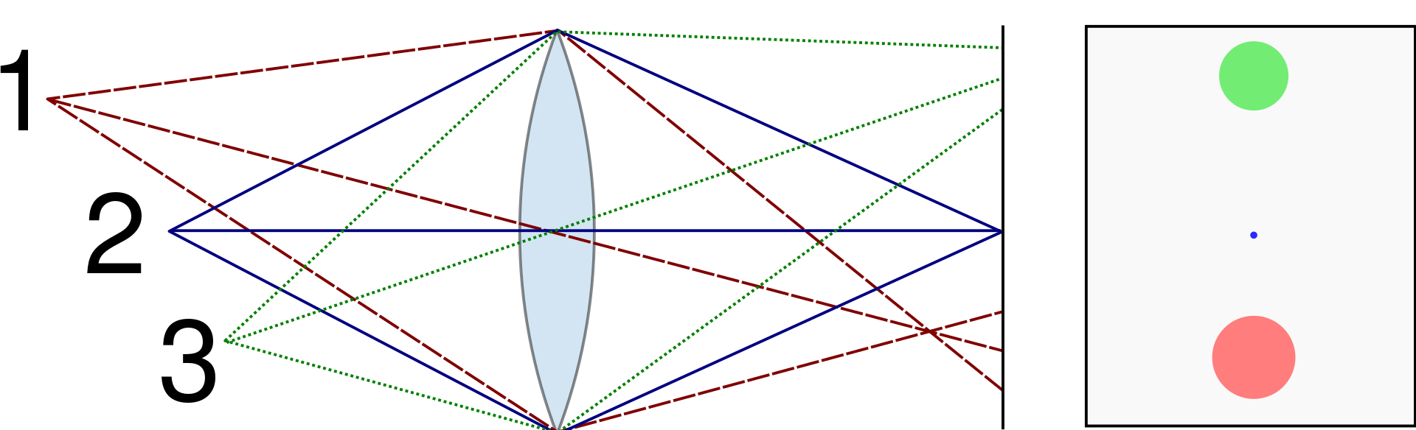
Depth of field (DOF)
Depth of field is the distance between the nearest and the farthest objects that are in acceptably sharp focus in an image.
“acceptably sharp” is human determined and is measured by the spot size that a point light is out of focus (called circle of confusion).

Slide 56
Digital single-lens reflex camera (DSLR)

Slide 57
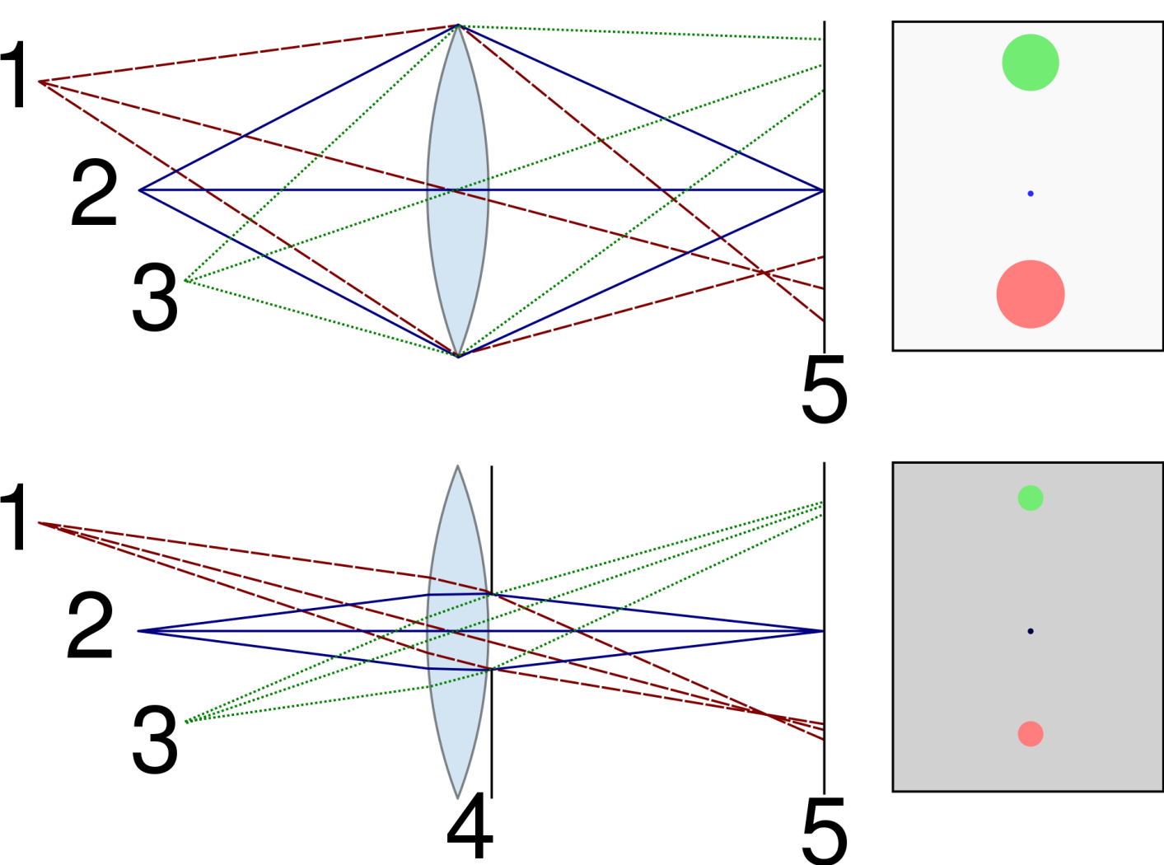
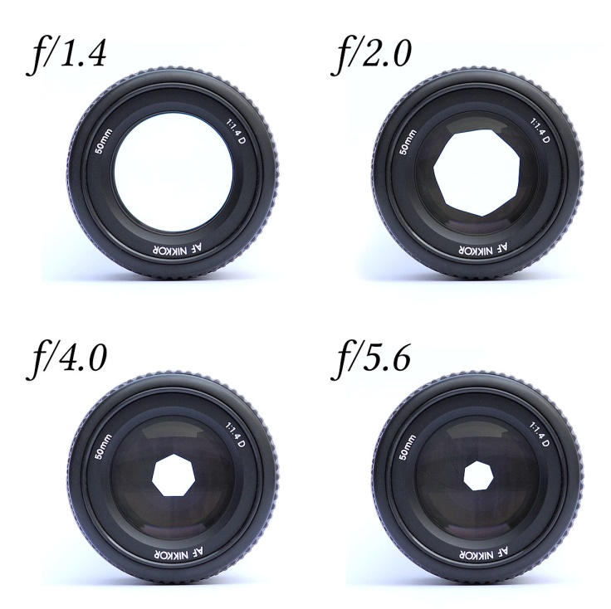
Aperture
An aperture is a hole or an opening through which light travels. The aperture helps enlarging the DOF, but also inputs less light, making the image darker.

Slide 58

Side note: aperture blur
Changing the default shape of the aperture will give different shapes to “circle of confusion”.

Slide 59


Side note: aperture blur
Changing the default shape of the aperture will give different shapes to “circle of confusion”.

Slide 60
Digital single-lens reflex camera (DSLR)

Slide 61
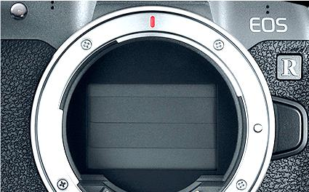
shutter
A common why to make the image lighter is to increase exposure time (also called “shutter speed”, although measurements units are seconds).
Larger exposure time can also lead to image blur if camera is not stable during capture
https://www.youtube.com/watch?v=ptfSW4eW25g (shutter and reflex mirror operation slow-motion)

Slide 62
Digital single-lens reflex camera (DSLR)

Slide 63
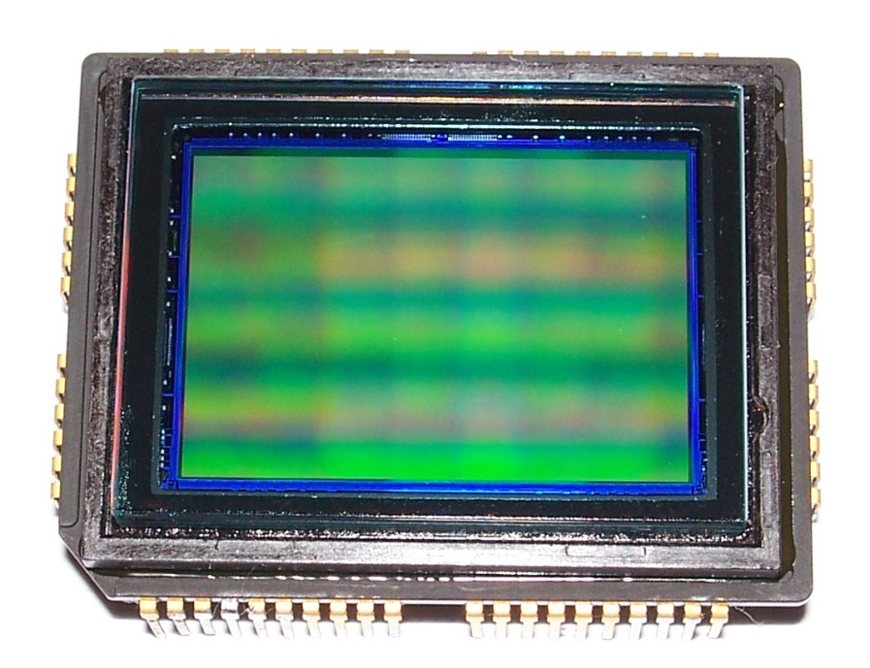
Photosensors
Sensor that transforms different input light intensities to different valued electrical charges.
Each pixel in the resulting color image comes from at least 3 capacitors in a 2D array which makes the sensor (R, G and B).
Two types of such sensors are called CCD (charge-coupled device) or CMOC (complementary metal-oxide-semiconductors).

Slide 64
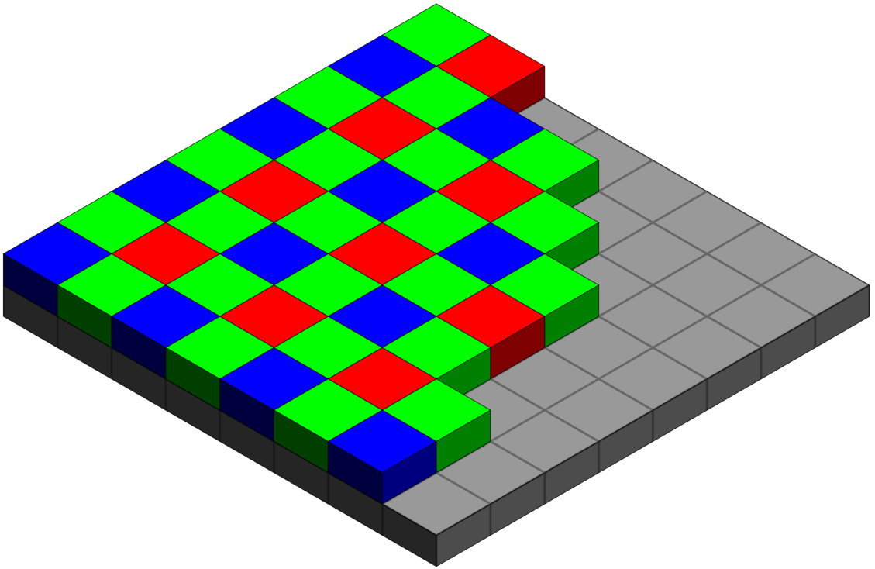

Bayer filter
On top of each photosensor is a Bayer filter which filters the input light to one of the 3 primary colors R,G & B.
This filter has twice as much green elements compared to the others, to mimic the human eye physiology.

Slide 65
Contents
BRDF
Pinhole camera
Digital camera
The human eye

Slide 66

Human color perception
The modern camera tries to mimic the human eye:
Iris = aperture.
Lens.
Retina = photosensor.

Slide 67

Human color perception
In the retina there are two types of photoreceptors:
Rods: responsible for low-light vision – maximum sensitivity at the green region of 500nm. Rods are not responsible for color vision though.
Cones: responsible for color vision. 3 types (short, medium & long), each has maximum sensitive for different colors.

Slide 68

Human color perception
The eye color sensitivity (Luminosity function) was defined by experiments- one result from those experiments was that people are more sensitive to the green color- can be seen by summation over the 3 stimuli of 3 kinds of cones.
This is way Bayer filter has double the greens!

Slide 69
Human color perception
A lot more on color theory and perception in this short course (a link to the first class):
https://www.youtube.com/watch?v=iDsrzKDB_tA

